Slide 1
Mobile and Web Workshop with Azure and Cordova
Venkata Koppaka Kris Lankford
Software Architect VP, Product Management

Slide 2
Hello! I am Kris
@krislankford
http://blog.falafel.com/author/kris/

Slide 3
Hello! I am Venkata
@vkoppaka
http://blog.falafel.com/author/venkata-koppaka/

Slide 4
Mobile-first
Cloud-first
Notes:
Mobile-first/Cloud-first gives us (developers) the ability
To meet consumers/customer where they are
Bring great experiences we build to all platforms
Cloud provides
Agility
Scalability
Includes all platforms

Slide 5
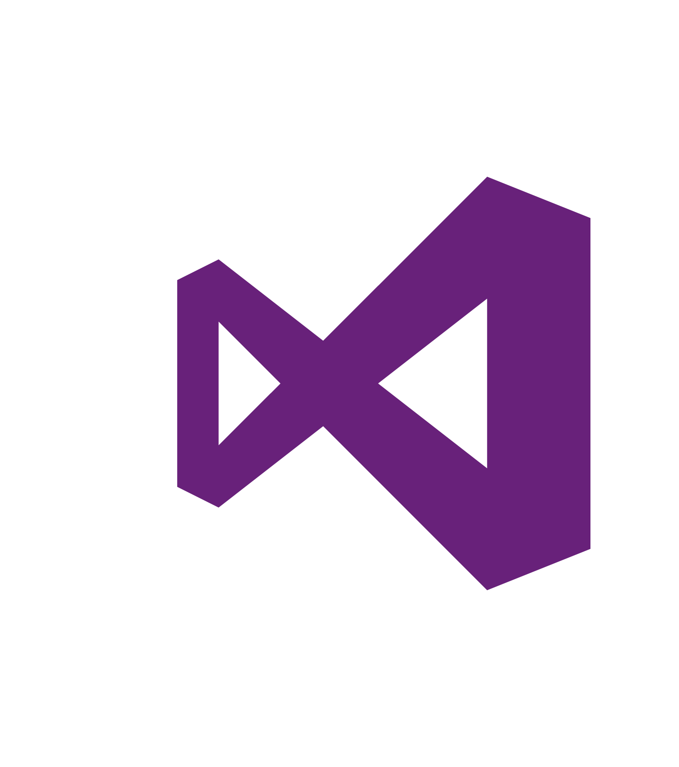

Develop Everywhere
Notes:
Cloud opens possibilities for development everywhere on all platforms
Using VS for
Windows
Mac & iOS
Linux & Android

Slide 6
Agenda
Introduction to Azure App Services and how we can use them in Mobile?
Workshop: Creating an Azure App Service
Introduction to Cordova & Ionic Framework
Workshop: Creating a Simple Ionic Application
How it all ties together
Workshop: Consuming Azure App Service Data from Cordova
What is Azure Machine Learning and how we can use it?

Slide 7
Follow Along, Do the Workshops
All the workshop content is at http://tinyurl.com/azurecordova please follow along with me.

Slide 8
Introduction to Azure App Services

Slide 9
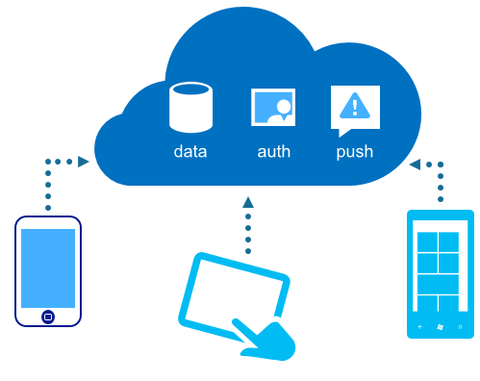
Easy way to build web and mobile apps fast
Use programming language of your choice, - .NET, NodeJS
Connect to a number of services using in built in “connectors”
App Types
Web Apps
Mobile Apps
API Apps
Logic Apps

Slide 10
Workshop: Building Azure Mobile App Service

Slide 11
What are my options for developing mobile apps?
Native Tools –
iOS (Swift)
Android (Java)
Windows Phone (C#)
Cross Platform Tools –
Apache Cordova – Build apps using HTML 5, JavaScript, CSS
Xamarin – Build apps using C#

Slide 12
Pros and Cons of each approach – Native
Pros
Native apps tend to perform the best.
100% API Coverage
First class IDEs support (Xcode, Android Studio, Visual Studio)
Cons
Multiple code bases, multiple teams, multiple skills
Tools: a Mac is required to do any development for iOS
Time and Money

Slide 13
Pros and Cons of each approach – Cross Platform
Pros
Single Code Base
Use the language and tools you already know and love
Access to most of the Native APIs
Cons
Performance
Vendor issues
Also, The Zuck Wrath!

Slide 14
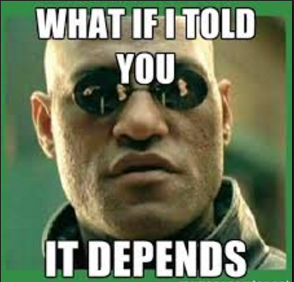
What to pick?

Slide 15
Introduction to Cordova

Slide 16

Apache Cordova apps are written in today's standard web technologies, HTML, JavaScript and CSS but can also access native device capabilities
Market share: 5.6% of apps 14% of business apps
Source: AppBrain May 2015

Slide 17
Cordova – The Pitch
Hybrid Apps: HTML5 web apps that act like native apps
Web wrapped in a native layer
Direct Access to native APIs
Run inside WebView
Single Code Base against iOS, Android, WP

Slide 18
Ionic Framework

Slide 19

Allows building Hybrid Apps with AngularJS, HTML5 and CSS.

Slide 20

Ionic Framework – The Pitch
Built on top of AngularJS
Extends HTML by adding a ton of “directives”
Built in UI Components to handle ton of grunt work tasks
CSS Components
Free to use Icons (http://ionicons.com/)
Minimal DOM Tax
No 300ms tap delay

Slide 21
Tools

Slide 22
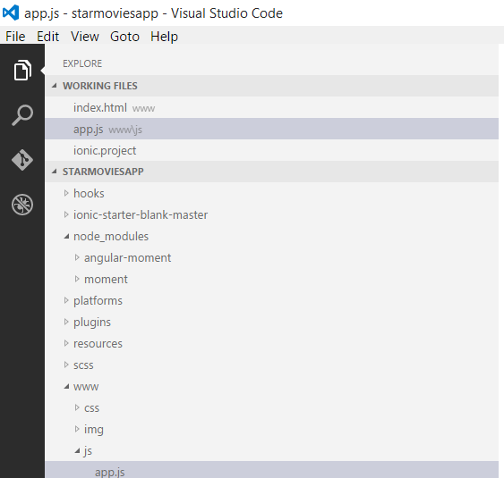
Visual Studio Code (on Mac or PC)
Visual Studio 2015 or Extension for Visual Studio 2013 on Windows with Cordova Tools Installed
Android SDK, Java JDK installed
npm packages for Ionic, Cordova, Bower Installed

Slide 23
Workshop: Creating a Simple Cordova App with Ionic Framework

Slide 24
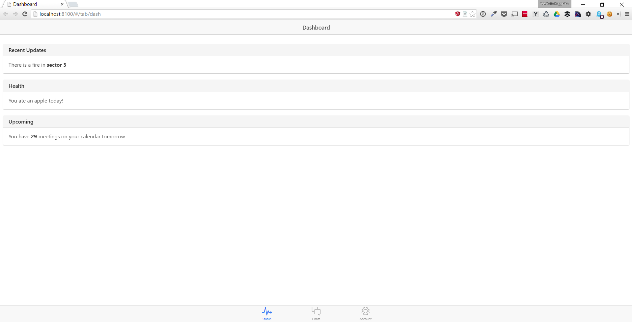
Result

Slide 25

Preview the App on Android
Using Android Emulator

Slide 26
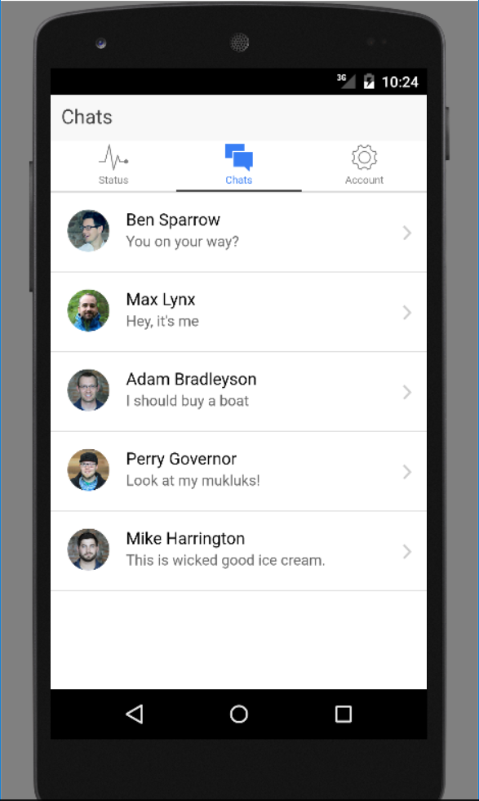
Result - Android

Slide 27
Workshop: How it all ties together

Slide 28
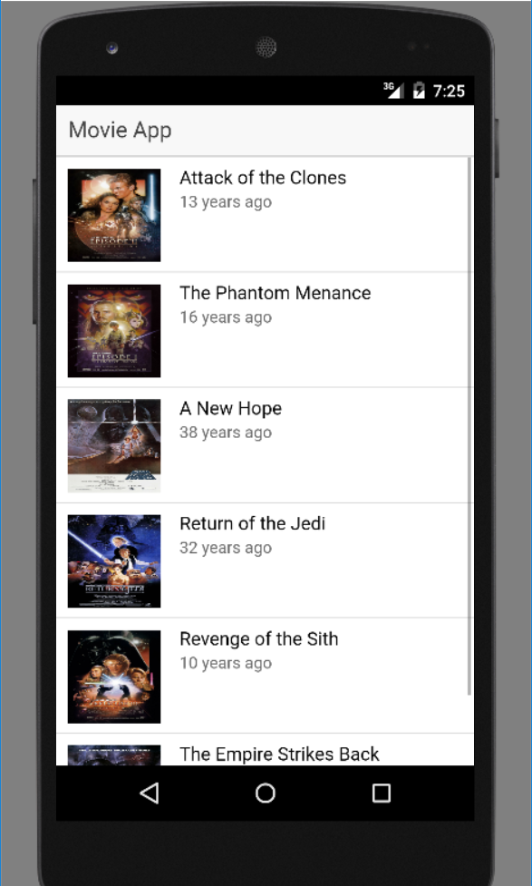
Result – The force is strong with this one

Slide 29
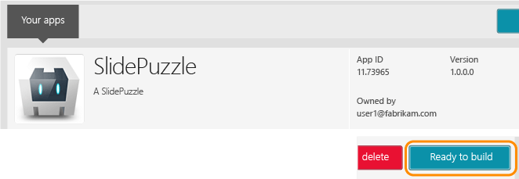
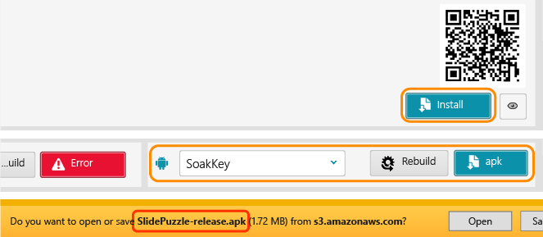

Build & Deploy
Adobe Phonegap Build
You need to convert your Apache Cordova project created using Visual Studio to a PhoneGap project to use Phonegap build
JavaScript Build System
Automate mundane tasks, lint code, run tests, pre-process assets, minify, convert to phonegap etc.
Deployment
Guidelines, checklists, policies, dos and don'ts, documentations, tutorials etc.
Grunt vs Gulp vs Broccoli vs Make vs Rake vs Jake vs Cake vs Brunch vs Ant vs Maven vs Bash vs ... Wait there's more

Slide 30
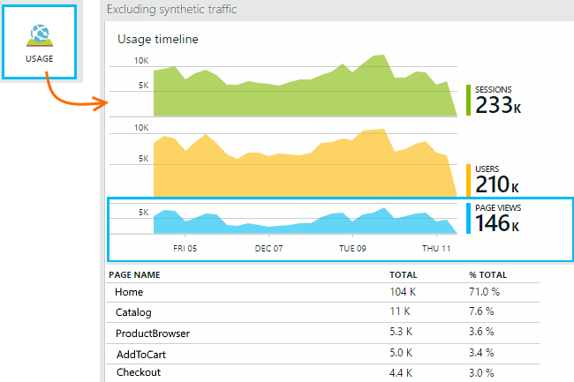
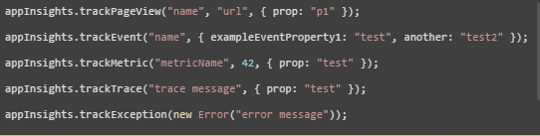
Monitor & Instrument
Application Insights
Collect telemetry in your mobile application
Telemetry is processed and stored in the Application Insights service in the cloud
Get a 360 view of the application including availability, performance and usage patterns
Powerful Insights
Built-in Analytics

Slide 31
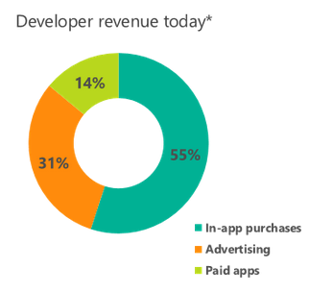
Monetize
Microsoft Advertising
Promote your app and display In-app advertising throught the SDK. Only available for Windows and Windows Phone.
Google AdMob & Apple iAd
AdMob & iAd are both solutions for mobile advertisements. Plugins exist for both.
Cordova In-App Purchase Plugin
In 2014, a small crowd funding campaign brought Android support to a plugin that only supported iOS.
(*) Worldwide, Microsoft internal Q1, 2015
acquiring users and monetizing your apps, //Build/ 2015

Slide 32
Questions?

Slide 33
console.log(“Thank You”);

